Slide 1
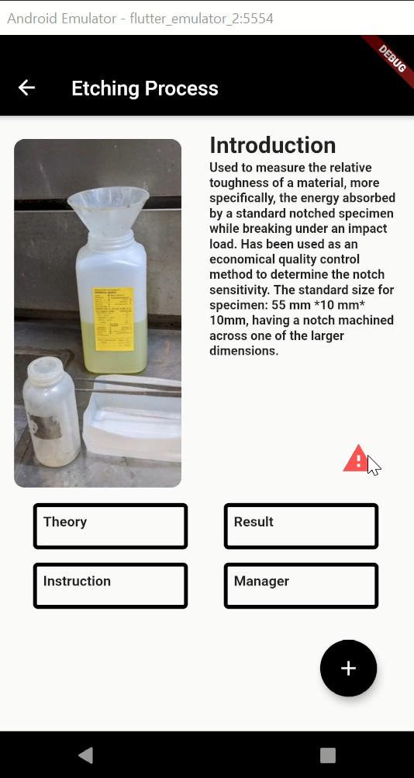
If hazard chemical are used in experiment
Student have to read the document about the chemical about to use and pass a quick quiz to get the code for the lock.

Slide 2
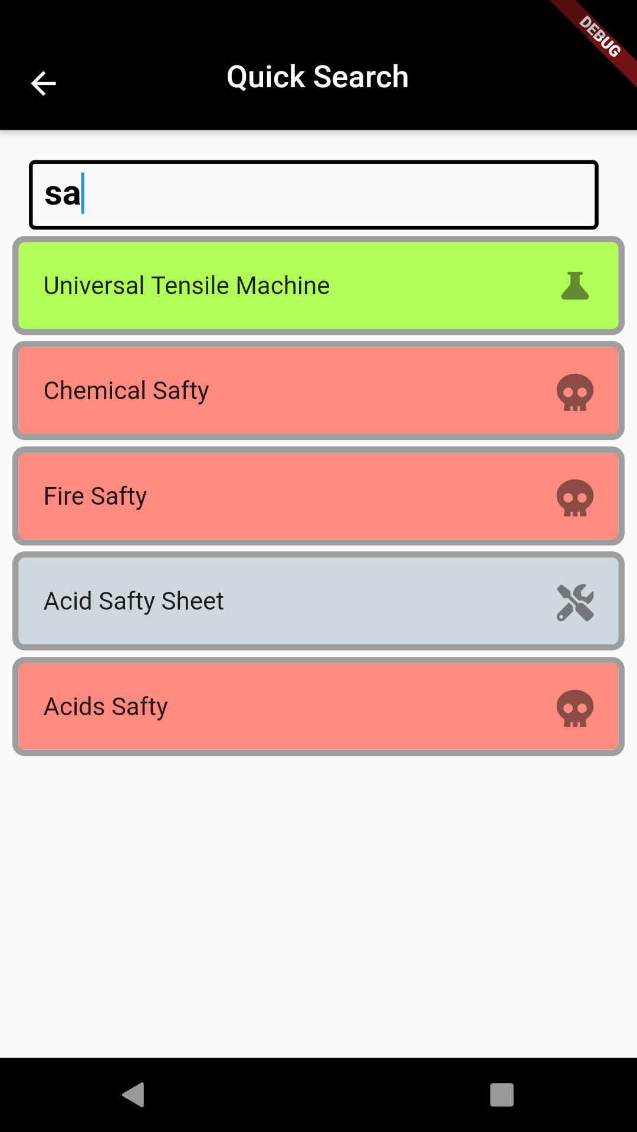
Direct Search:
Find the item you want by direct search the word

Slide 3
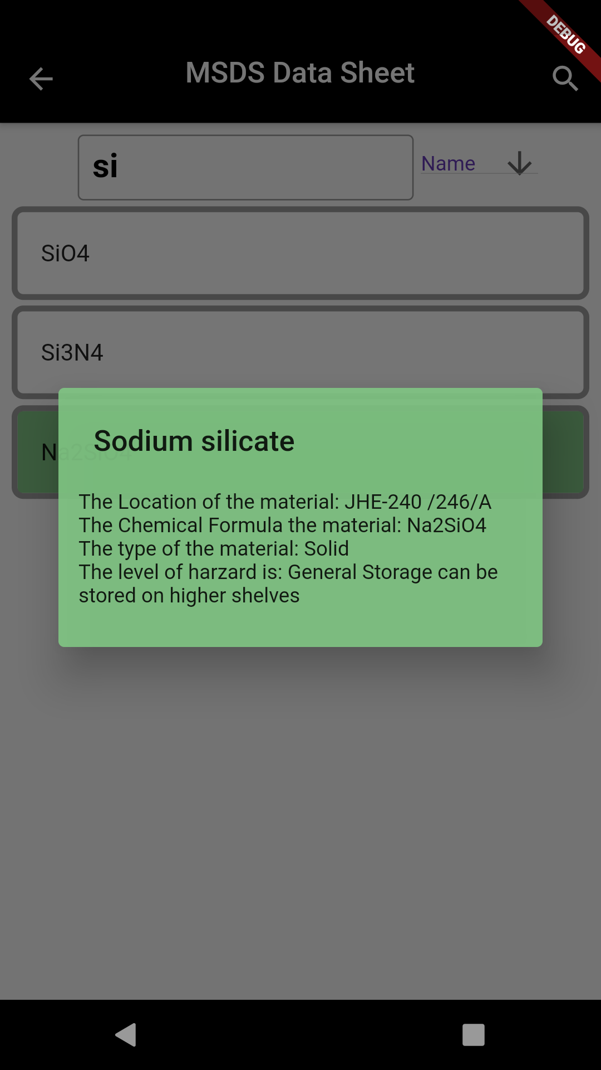
Search for MSDS chemical sheet
To get the location of the chemical and the level of hazard
Using both names and chemical formula search

Slide 4
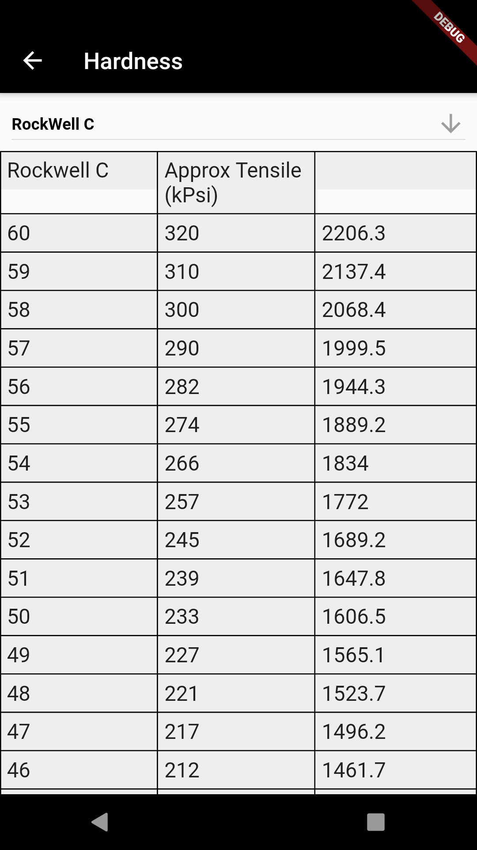
Hardness Conversion sheet
Can switch between the most used hardness type to convert the data got from the equipment to commonly used unit
It can apply to other machine as well

Slide 5
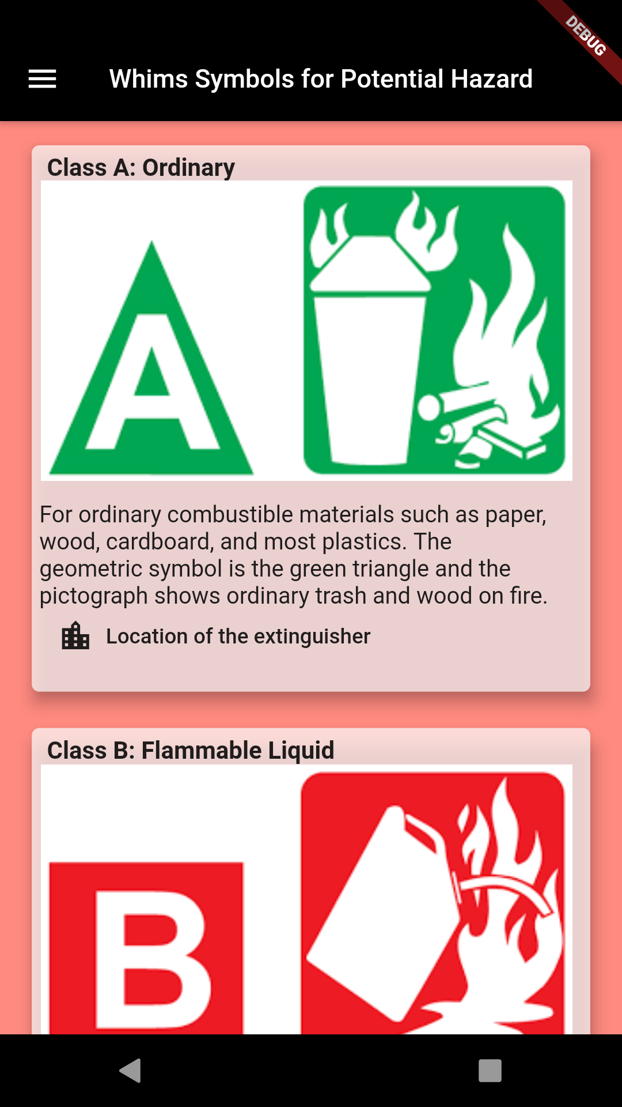
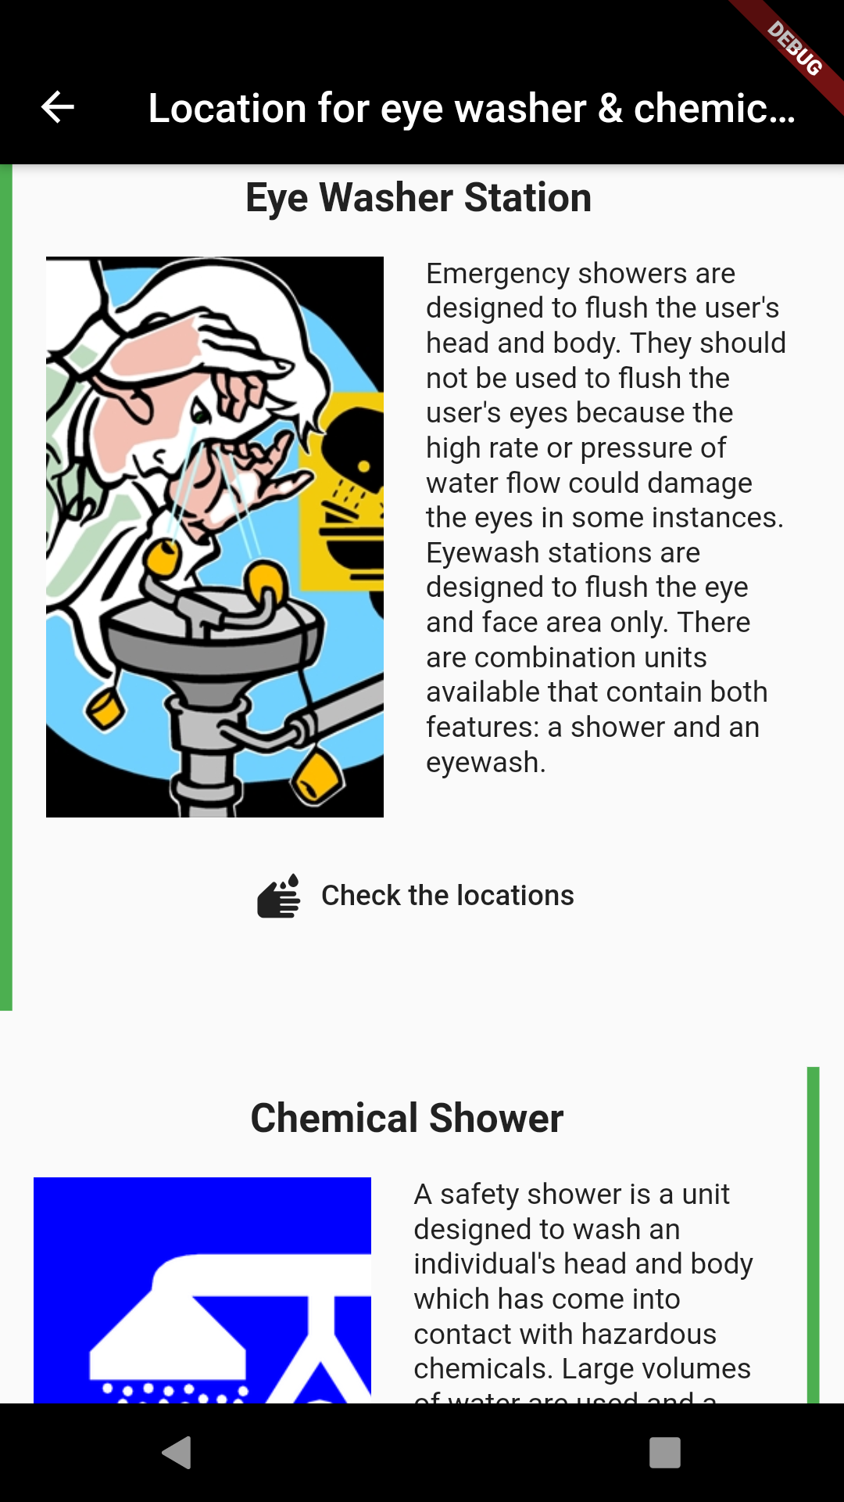
Safety:
Easier way to locate the safety equipment including chemical shower, eye wash, extinguisher, chemical spill kit, first aid kit on the map before going to the lab

Slide 6
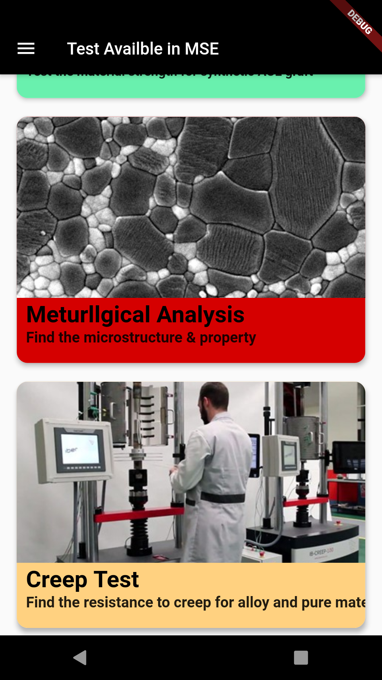
Case Study
By introducing the case that the test can be perform on the equipment to help student connect the lab with the real life application

Slide 7
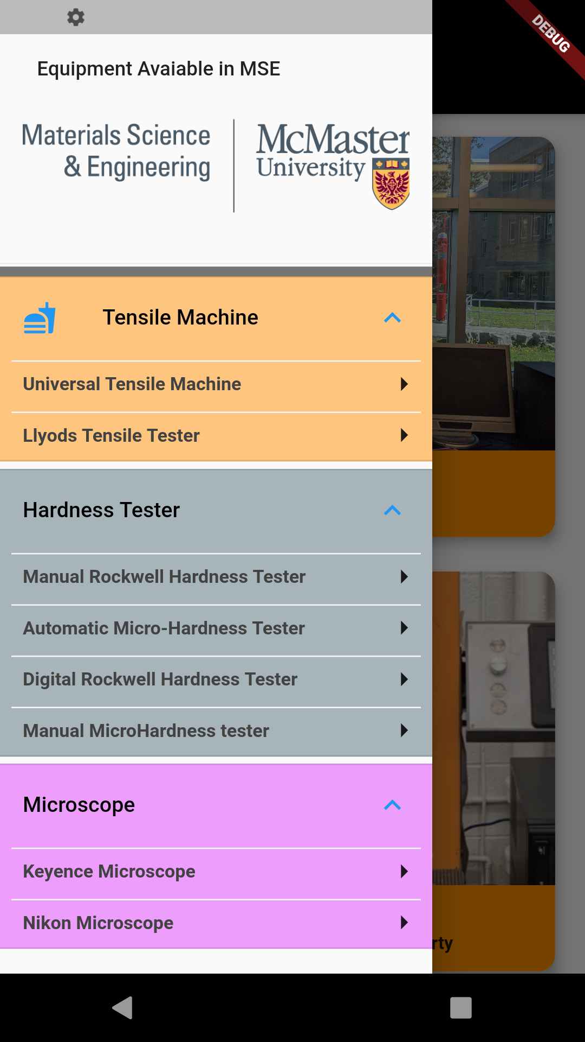
Color Coded equipment list
Better UI design and help student to find the equipment more easily,

